Slide 1
Ada Boosting Algorithm

Slide 2
Ada Boosting Algorithm
AdaBoost, short for Adaptive Boosting, is an ensemble machine learning algorithm that can be used in a wide variety of classification and regression tasks. It is a supervised learning algorithm that is used to classify data by combining multiple weak or base learners (e.g., decision trees) into a strong learner. AdaBoost works by weighting the instances in the training dataset based on the accuracy of previous classifications.

Slide 3
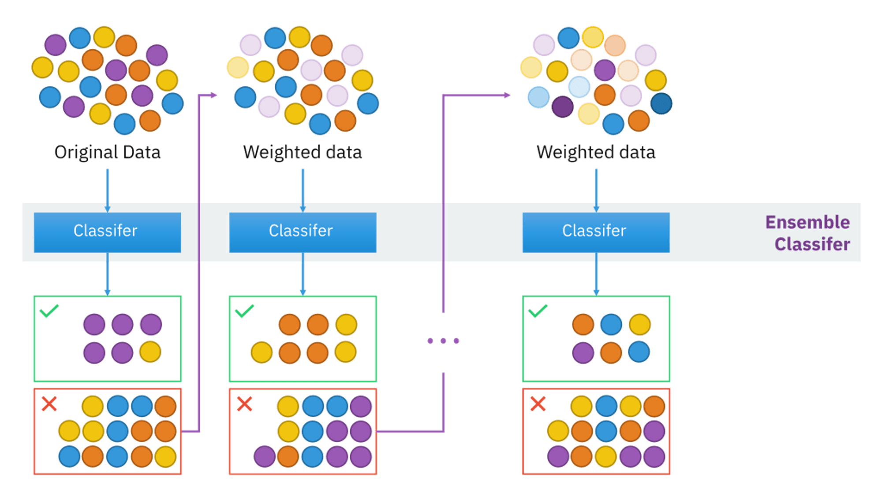

Slide 4
Ada Boosting Algorithm
Boosting algorithms work on the idea of first building a model on the training dataset and then building a second model to correct the faults in the first model. This technique is repeated until the mistakes are reduced and the dataset is accurately predicted. Boosting algorithms function similarly in that they combine numerous models (weak learners) to produce the final result (strong learners).

